Slide 1
20
Income Inequality and Poverty

Slide 2

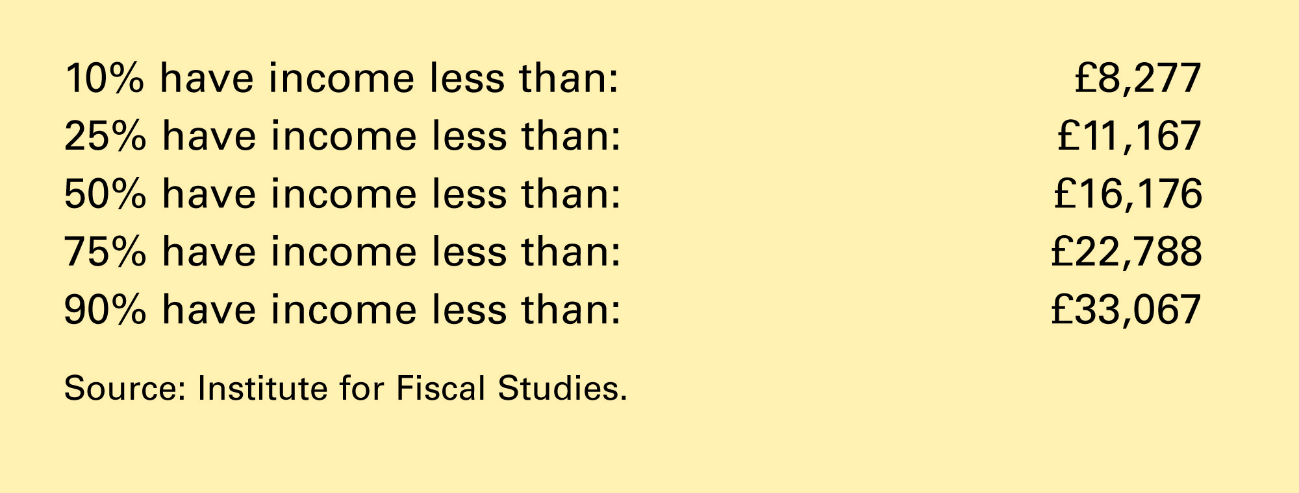
Table 1 The Distribution of Annual Family Income in the United Kingdom: 2002
Copyright©2004 South-Western

Slide 3
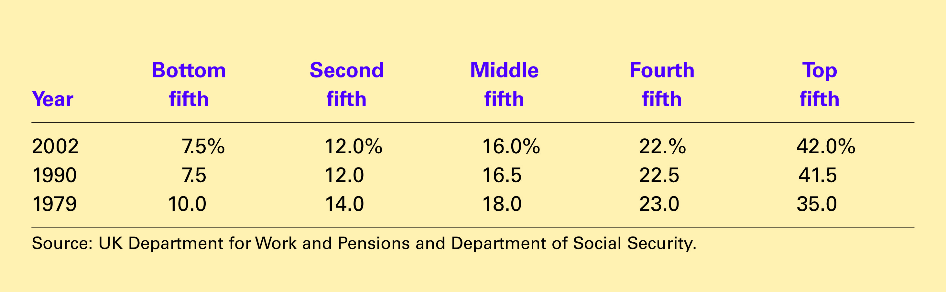
Table 2 Income Inequality in the United Kingdom
Copyright©2004 South-Western

Slide 4
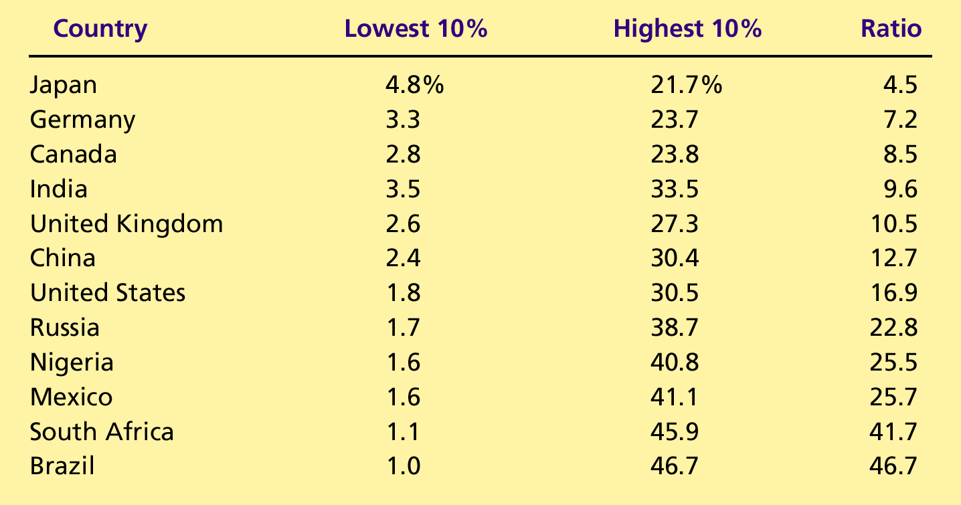
CASE STUDY: Income Equality around the World

